Slide 1
Closing: User Interface Design, Program design and System Implementation
Team Alexandria

Slide 2
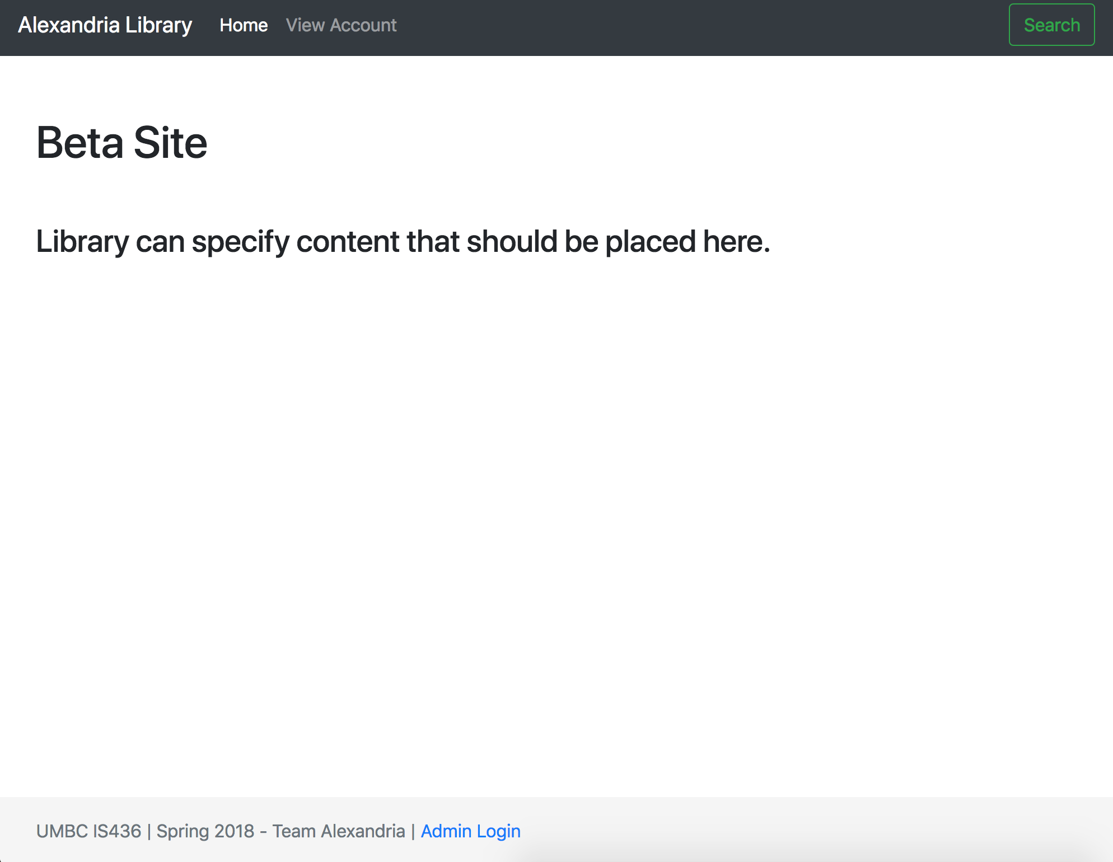
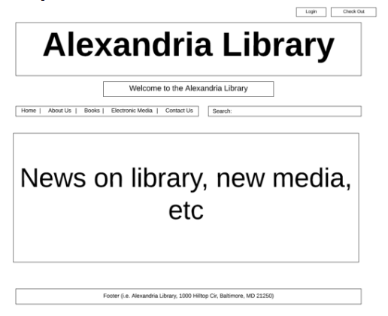
User Interface Design
Home Page

Slide 3
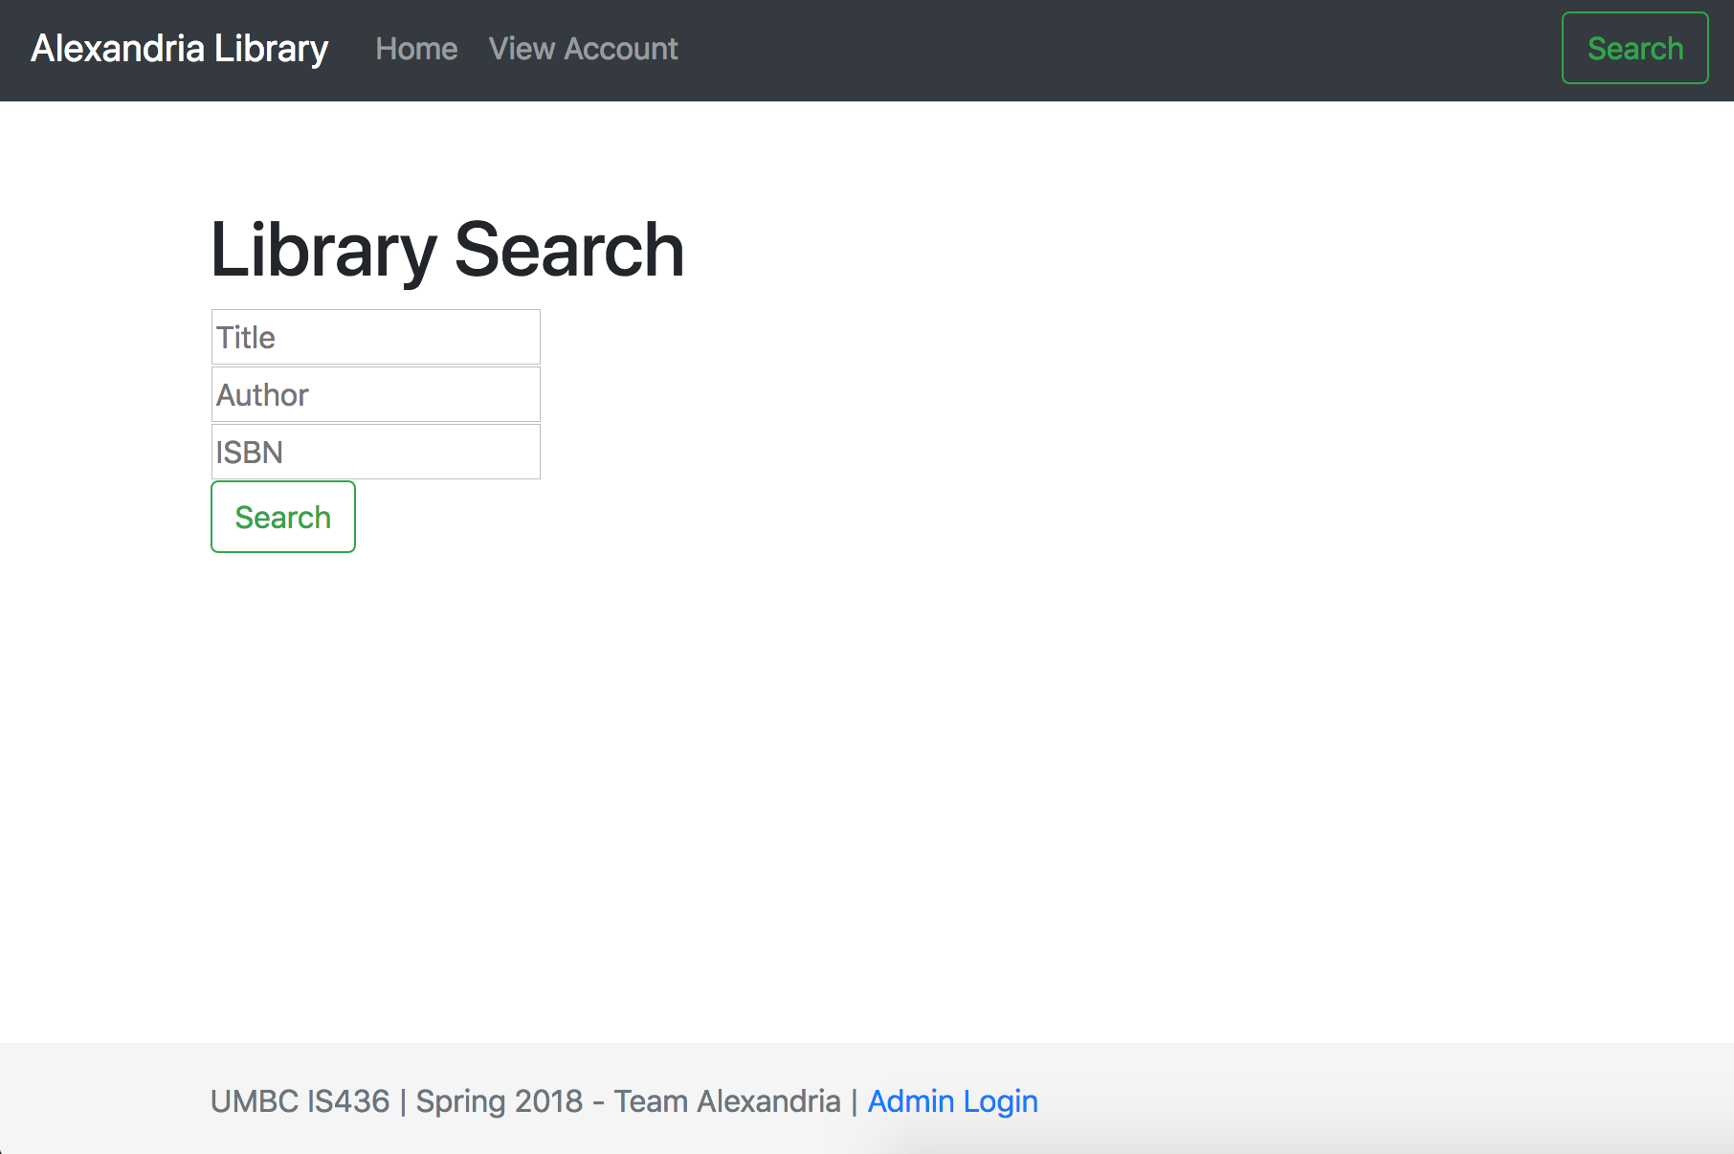
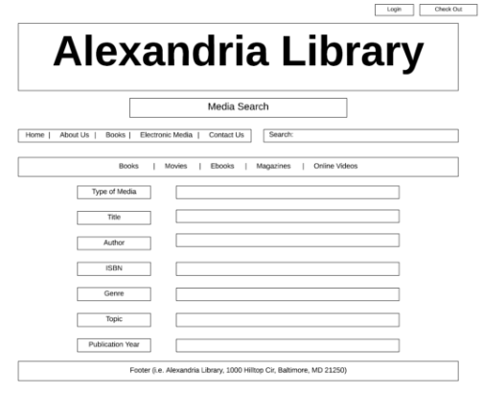
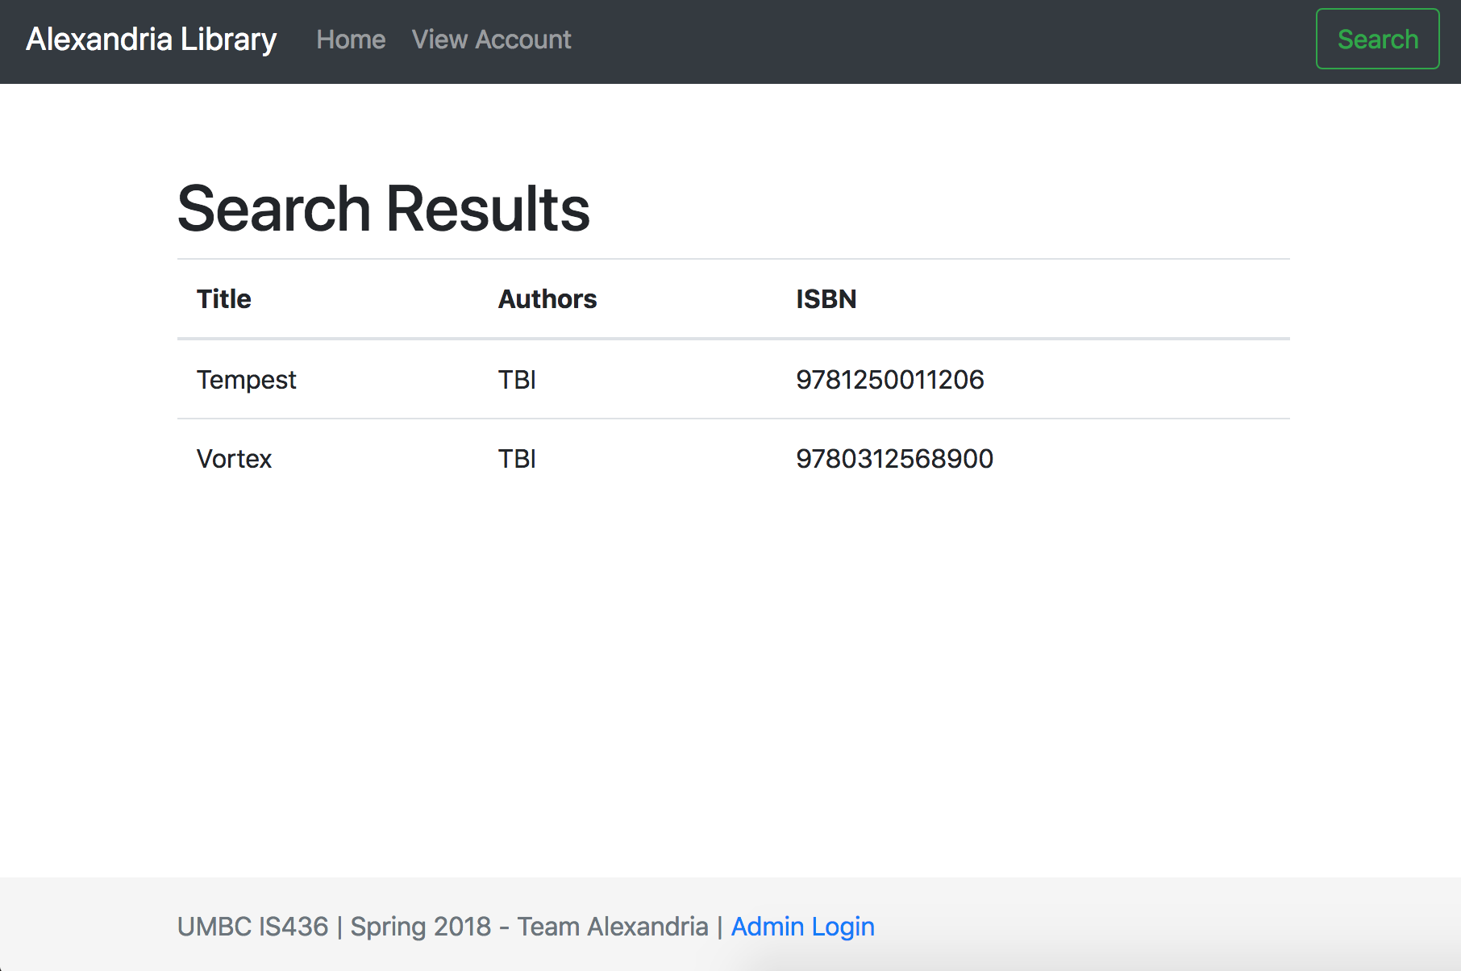
Search Page

Slide 4
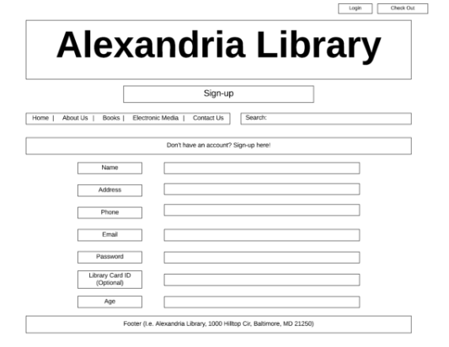
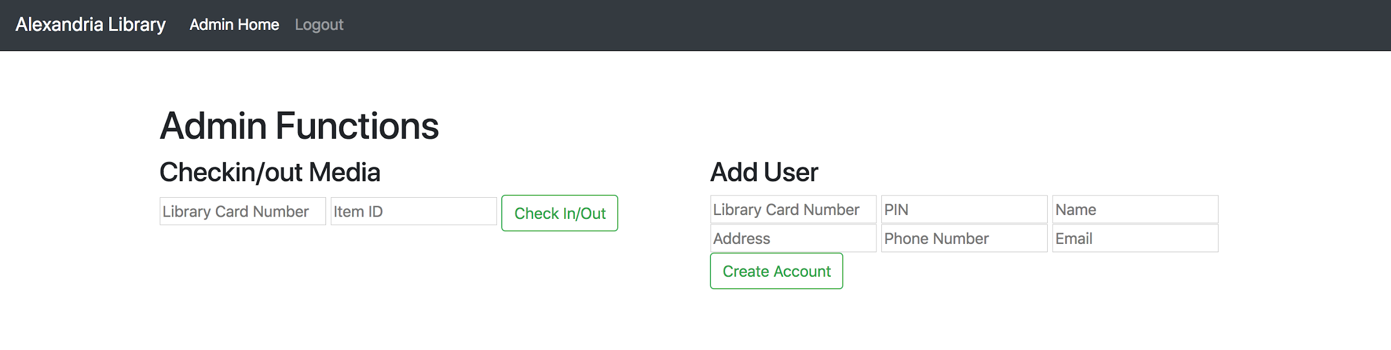
Sign-up Page

Slide 5
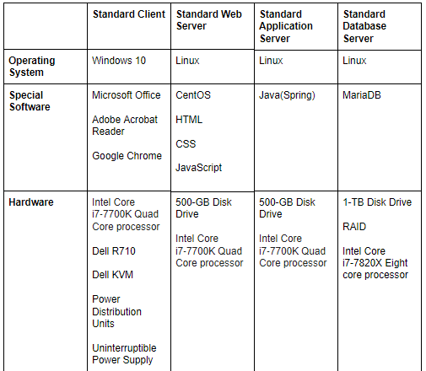
System Requirements

Slide 6
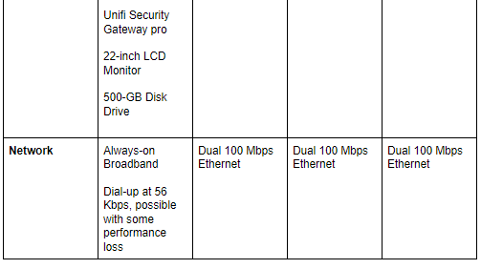
System Requirements (Cont.)

Slide 7
SDLC Process Difficulties
Planning - During the planning phase we ran into the challenge of what the actual project would accomplish. We wanted to have a clear vision of what was needed from the application. This was quite challenging but we conducting a few group meetings and were able to come up with a good idea.
Analysis- We wanted to test how feasible it would be to implement the new project and to do this we conducted a feasibility study . The feasibility study was very rewarding because it helped us understand how much of a difference the concept we drew up would make.

Slide 8
SDLC Process Difficulties (Cont.)
Design - During the design phase we did not face any challenges as we all agreed on the UI, program and data storage designs. The main designs were created by our scrum master and he did accept input for everyone else on the group.
Implementation - The only major challenge we faced in implementation was the choice of who would implement the program. We were torn between outsourcing and a hybrid of outsourcing and inhouse. We decided to go with hybrid implementation because it would allow for more professional implementation of the program.

